Slide 1
MARKETING
BY
ASMATULLAH KHAN

Slide 2
What Is Marketing?
Marketing, more than any other business function, deals with customers. Although we will soon explore more-detailed definitions of marketing, perhaps the simplest definition is this one: Marketing is managing profitable customer relationships. The twofold goal of marketing is to attract new customers by promising superior value and keep and grow current customers by Delivering satisfaction

Slide 3
Today, marketing must be understood not in the old sense of making a sale—“telling and selling”—but in the new sense of satisfying customer needs. If the marketer understands consumer needs; develops products that provide superior customer value; and prices, distributes, and promotes them effectively, these products will sell easily. In fact, according to management guru Peter Drucker, “The aim of marketing is to make selling unnecessary.”3 Selling and advertising are only part of a larger “marketing mix”—a set of marketing tools that work together to satisfy customer needs and build customer relationships

Slide 4
Marketing defination
The process by which companies create value for customers and build strong customer relationships in order to capture value from customers in return

Slide 5
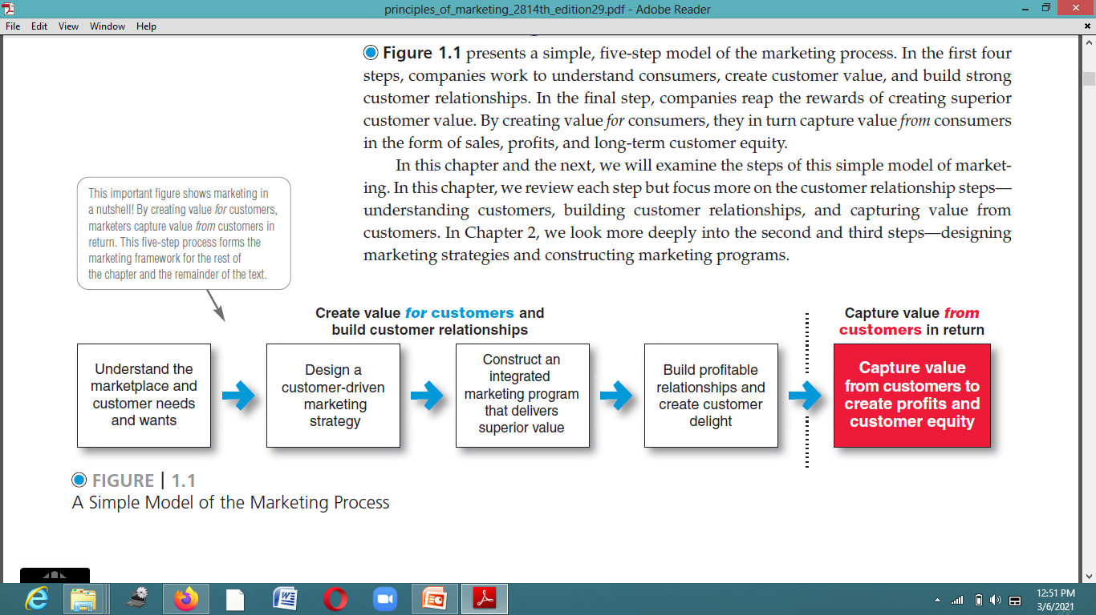
The Marketing Process

Slide 6
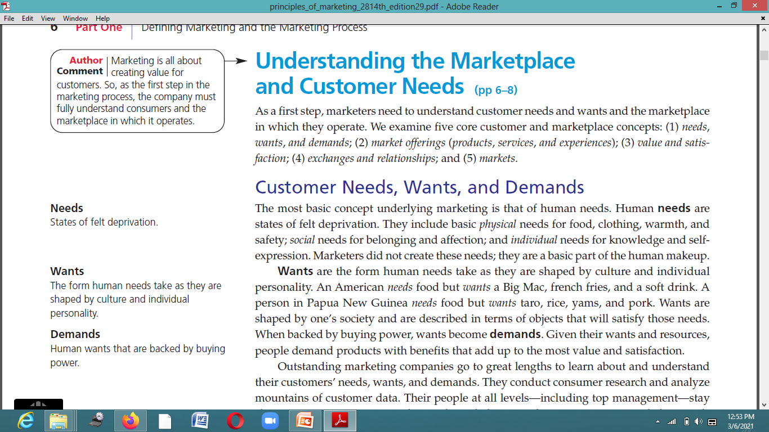

Slide 7
Customer Value and Satisfaction
Consumers usually face a broad array of products and services that might satisfy a given need. How do they choose among these many market offerings? Customers form expectations about the value and satisfaction that various market offerings will deliver and buy accordingly. Satisfied customers buy again and tell others about their good experiences. Dissatisfied customers often switch to competitors and disparage the product to others. Marketers must be careful to set the right level of expectations. If they set expectations too low, they may satisfy those who buy but fail to attract enough buyers. If they set expectations too high, buyers will be disappointed. Customer value and customer satisfaction are key building blocks for developing and managing customer relationships. We will revisit these core concepts later in the chapter.

Slide 8
Exchanges and Relationships
Marketing occurs when people decide to satisfy needs and wants through exchange relationships. Exchange is the act of obtaining a desired object from someone by offering something in return. In the broadest sense, the marketer tries to bring about a response to some market offering. The response may be more than simply buying or trading products and services. Apolitical candidate, for instance, wants votes, a church wants membership, an orchestra wants an audience, and a social action group wants idea acceptance.

Slide 9
Markets
The concepts of exchange and relationships lead to the concept of a market. Amarket is the set of actual and potential buyers of a product or service. These buyers share a particular need or want that can be satisfied through exchange relationships. Marketing means managing markets to bring about profitable customer relationships. However, creating these relationships takes work. Sellers must search for buyers, identify their needs, design good market offerings, set prices for them, promote them, and store and deliver them. Activities such as consumer research, product development, communication, distribution, pricing, and service are core marketing activities.

Slide 10
Marketing Management Orientations
The Production Concept
The idea that consumers will favor products that are available and highly affordable and that the organization should therefore focus on improving production and distribution efficiency

Slide 11
The Product Concept
The idea that consumers will favor products that offer the most quality, performance, and features and that the organization should therefore devote its energy to making continuous product improvements.

Slide 12
The Selling Concept
The idea that consumers will not buy enough of the firm’s products unless it undertakes a large-scale selling and promotion effort.
Such aggressive selling, however, carries high risks. It focuses on creating sales transactions rather than on building long-term, profitable customer relationships. The aim often is to sell what the company makes rather than making what the market wants. It assumes that customers who are coaxed into buying the product will like it. Or, if they don’t like it, they will possibly forget their disappointment and buy it again later. These are usually poor assumptions.

Slide 13
The Marketing Concept
A philosophy that holds that achieving organizational goals depends on knowing the needs and wants of target markets and delivering the desired satisfactions better than competitors do.

Slide 14
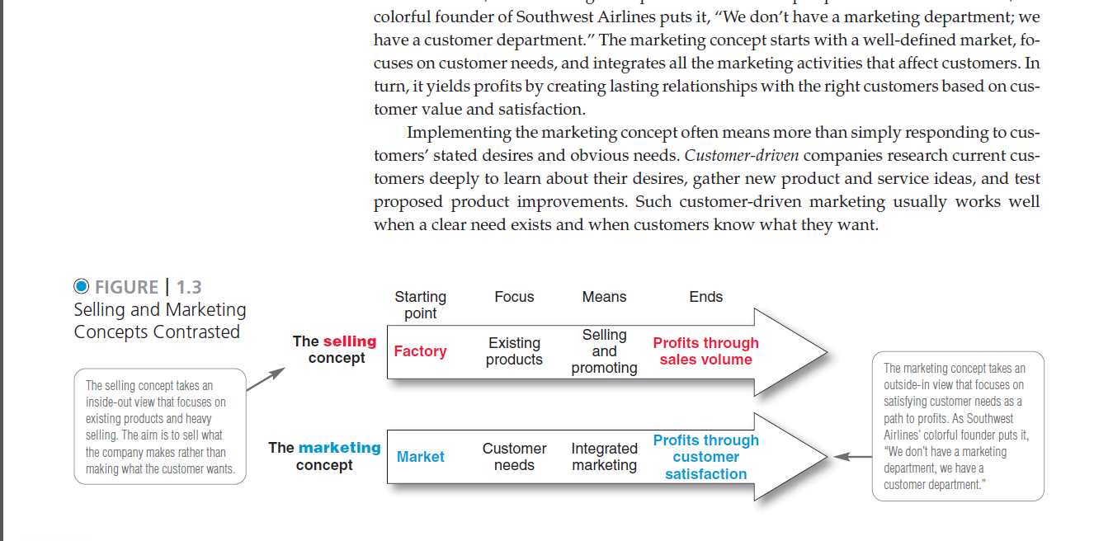
Difference between selling and marketing concept

Slide 15
The Societal Marketing Concept
The societal marketing concept questions whether the pure marketing concept overlooks possible conflicts between consumer short-run wants and consumer long-run welfare. Is a firm that satisfies the immediate needs and wants of target markets always doing what’s best for its consumers in the long run? The societal marketing concept holds that marketing strategy should deliver value to customers in a way that maintains or improves both the consumer’s and society’s well-being. It calls for sustainable marketing, socially and environmentally responsible marketing that meets the present needs of consumers and businesses while also preserving or enhancing the ability of future generations to meet their needs

